Slide 1
THE VENDING MACHINE
PREPARE BY: AHMED BILAL #011
YAHYA REHAN #024
MALAIKA JAVED #015
MIAN WAQAS #026
AZFAR ASIF #023

Slide 2
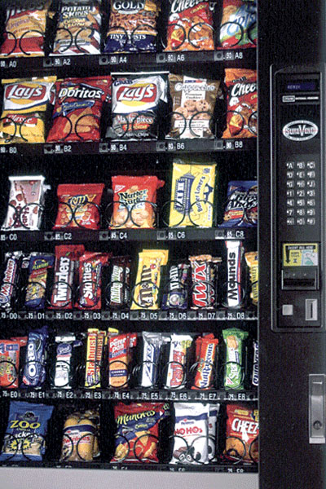
What is a vending machine?
A vending machine is an automated machine that provides items such as snacks,and beverages to consumers after cash, a credit card, or a specially designed card is inserted into the machine.

Slide 3
How does our vending machine work?
We have limited our machine to work only if the cash is inserted in the form of 10,20 ,50 ,100.
Our machine will not work if invalid money is inserted.
In order to use our machine you need to follow these steps:
Insert money only in the form of 10,20,50,100 .
Select you desired item from the menu by pressing item number which is listed in the menu.
The number of items you can buy depends upon the ammount you entered.
If you have some ammount left and you want to buy another item you can repeat the procedure or you can just take your item and enjoy.

Slide 4
First part of the code:
print(" \n WELCOME TO MACHINE!")
money=int(input("\nEnter Money In The Form Of RS 10,20,50,100: "))
print("\n")
In this part we have displayed a welcome note to our customer who wants to use are machine,then we have given an instruction to the customer about what to do next in order to buy something.

Slide 5
Second part of the code:
if money==10 or money==20 or money==50 or money==100:
while True:
print("Press 1 For Lays : Rs20")
print("Press 2 For Potato Stick : Rs10")
print("Press 3 For Wavy : Rs25")
print("Press 4 For Pringels : Rs80")
print("Press 5 For 500ml Coca Cola : Rs40")
print("press 6 for 500ml Pepsi : Rs40")
print("press 7 for KitKat : Rs45")
print("press 8 for Nimko : Rs35")
print("press 9 for Milo : Rs60")
print("press 10 for Marshmallow : Rs100")
In this part of the code we have used the if statement that if the money our customer entered is in the correct form than a menu will pop up with the names and prices of all the items in our machine.

Slide 6
Third part of the code:
choice = int(input("\nENTER PRODUCT NUMBER TO PURCHASE: "))
In this part of the code we have given user a choice that if the user wants to purchase an item then he should enter the product number which were given in the menu .

Slide 7
Choice number 1:
if choice == 1:
if money > 20 or money == 20:
choice_2 = int(input("Enter 1 to Continue and 0 to Terminate "))
if choice_2 == 1:
money = money - 20
print("\n YOUR CHOICE IS Lays and your left money is ", money)
elif choice_2 == 0:
print("exiting...")
else:
print("invalid choice, please try again!")
else:
print("you don't have enough money to buy that!")

Slide 8
Choice number 2:
elif choice == 2:
if money > 10 or money == 10:
choice_2 = int(input("enter 1 to continue and 0 to terminate "))
if choice_2 == 1:
money = money - 10
print("your choice is potato sticks and your left money is ", money)
elif choice_2 == 0:
print("exiting...")
else:
print("invalid choice, please try again!")
else:
print("you don't have enough money to buy that!")

Slide 9
Choice number 3:
elif choice == 3:
if money > 25 or money == 25:
choice_2 = int(input("enter 1 to continue and 0 to terminate "))
if choice_2 == 1:
money = money - 25
print("your choice is wavy and your left money is ", money)
elif choice_2 == 0:
print("exiting...")
else:
print("invalid choice, please try again!")
else:
print("you don't have enough money to buy that!")

Slide 10
Choice number 4:
elif choice == 4:
if money > 80 or money == 80:
choice_2 = int(input("enter 1 to continue and 0 to terminate "))
if choice_2 == 1:
money = money - 80
print("your choice is Pringels and your left money is ", money)
elif choice_2 == 0:
print("exiting...")
else:
print("invalid choice, please try again!")
else:
print("you don't have enough money to buy that!")

Slide 11
Choice number 5:
elif choice == 5:
if money > 40 or money == 40:
choice_2 = int(input("enter 1 to continue and 0 to terminate "))
if choice_2 == 1:
money = money - 40
print("your choice is 500ml coca cola and your left money is ", money)
elif choice_2 == 0:
print("exiting...")
else:
print("invalid choice, please try again!")
else:
print("you don't have enough money to buy that!")

Slide 12
Choice number 6:
elif choice == 6:
if money > 40 or money == 40:
choice_2 = int(input("enter 1 to continue and 0 to terminate "))
if choice_2 == 1:
money = money - 40
print("your choice is 500ml Pepsi and your left money is ", money)
elif choice_2 == 0:
print("exiting...")
else:
print("invalid choice, please try again!")
else:
print("you don't have enough money to buy that!")

Slide 13
Choice number 7:
elif choice == 7:
if money > 45 or money == 45:
choice_2 = int(input("enter 1 to continue and 0 to terminate "))
if choice_2 == 1:
money = money - 45
print("your choice is KitKat and your left money is ", money)
elif choice_2 == 0:
print("exiting...")
else:
print("invalid choice, please try again!")
else:
print("you don't have enough money to buy that!")

Slide 14
Choice number 8:
elif choice == 8:
if money > 35 or money == 35:
choice_2 = int(input("enter 1 to continue and 0 to terminate "))
if choice_2 == 1:
money = money - 35
print("your choice is Nimko and your left money is ", money)
elif choice_2 == 0:
print("exiting...")
else:
print("invalid choice, please try again!")
else:
print("you don't have enough money to buy that!")

Slide 15
Choice number 9:
elif choice == 9:
if money > 60 or money == 60:
choice_2 = int(input("enter 1 to continue and 0 to terminate "))
if choice_2 == 1:
money = money - 60
print("your choice is Milo and your left money is ", money)
elif choice_2 == 0:
print("exiting...")
else:
print("invalid choice, please try again!")
else:
print("you don't have enough money to buy that!")

Slide 16
Choice number 10:
elif choice == 10:
if money > 100 or money == 100:
choice_2 = int(input("enter 1 to continue and 0 to terminate "))
if choice_2 == 1:
money = money - 100
print("your choice is Marshmallow and your left money is ", money)
elif choice_2 == 0:
print("exiting...")
else:
print("invalid choice, please try again!")
else:
print("you don't have enough money to buy that!")

Slide 17
We have used the if else and elif statements in these choices.
First the user is asked to press 1 to continue or press 0 to terminate, if the user press1 then the machine will check the choice number user have selected then the machine will check the ammount user have entered. If the ammount is correct the user will be able to buy what he selected else the screen will show a invalid money or invalid choice notes.

Slide 18
Fourth part of the code:
choice_3 = str(input("Do you want to buy something else? yes or no: "))
if choice_3 == "yes":
continue
else:
break
print("\n Goodbye")
else:
print("\n enter valid money enter money only in the form of 10 20 50 100")
In this part of the code the machine will ask the user that if they want to buy something else if the user enters yes then the machine will continue working else the machine will show the note Good Bye because we have used the break statement. At the last we have use else for the if statement we have used at the start of the code if that doesn't work the screen will show invalid money note.

